Slide 1
S-01B To Disable JTAG ODT and Enable Onboard Terminations
NVL-S
Suggested Rework Document

Slide 2
S-01B
To Disable JTAG ODT and Enable Onboard Terminations
Change Log | 2025 WW28.1 : Initialized 2025 WW28.3 : Adding S031 portion and modifying the title and description for clarity 2025 WW32.7 : Modifying the pull-up resistors for PREQ_N, PRDY_N, MBPB[0], MBPB[1] 2025 WW34.5 : Adding the delta note from S-01A to S-01B
Description | This is a rework to disable JTAG ODT and replace it with the onboard terminations to cover the A0 silicon bugs.
Impact | Without this rework, DBC/XDP won’t be able to function.
Rework Involved | SMD Resistors
SKUs | S01x/S02x/S031 RVP
Contacts | Lai, Kenneth ; Lin, Nick1 ; Liu, Yuan Erh
HSD Link | https://hsdes.intel.com/appstore/article-one/#/article/22021359138 https://hsdes.intel.com/appstore/article-one/#/article/22021359156
Collateral Link | N/A
SW Dependency | N/A

Slide 3
Index
Board SKU | Index
S01x/S02x | Refer to p.4 ~ p.10
S031 | Refer to p.11 ~ p.17
Those boards with S-01A implemented already | Refer to p.18~p.30

Slide 4
S01x/S02x

Slide 5
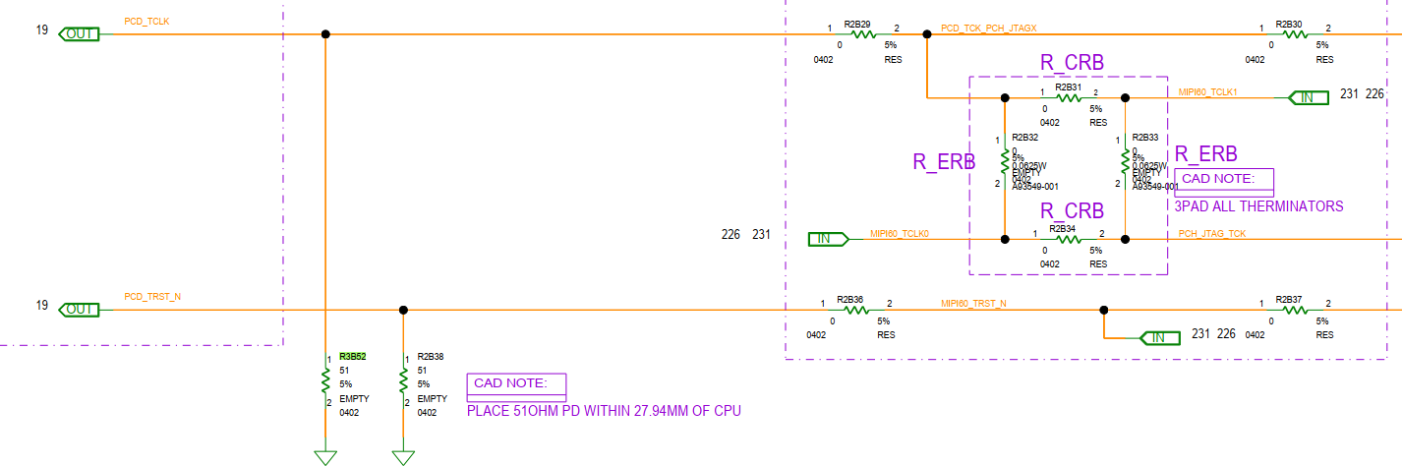
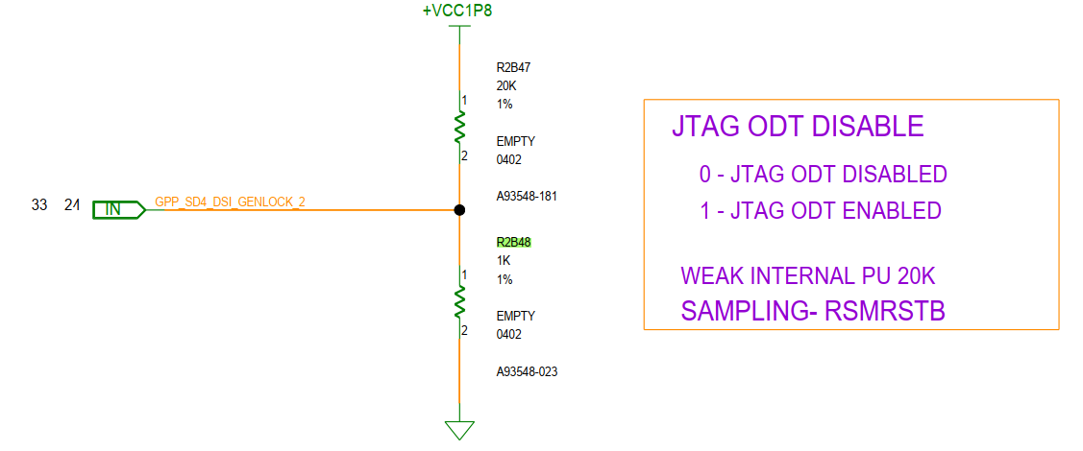
S01x/S02x TOP

Slide 6
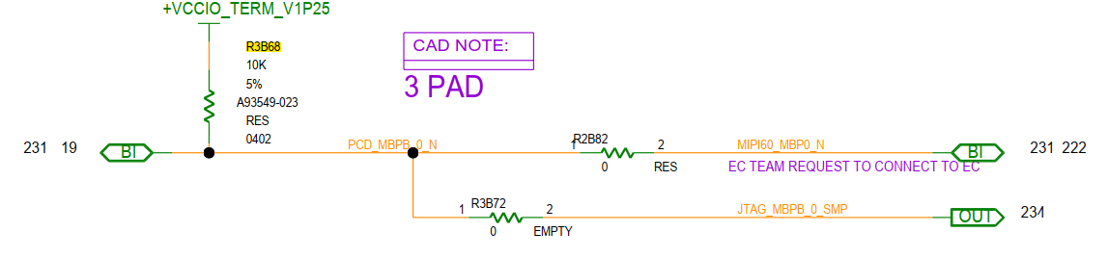
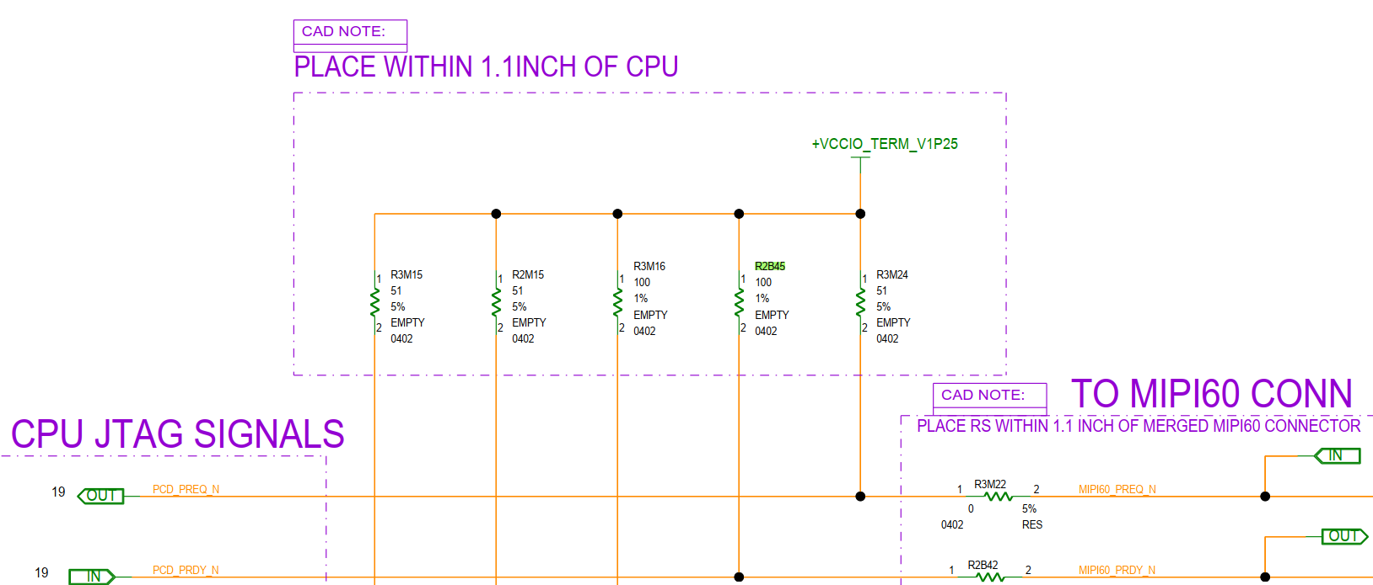
S01x/S02x TOP

Slide 7
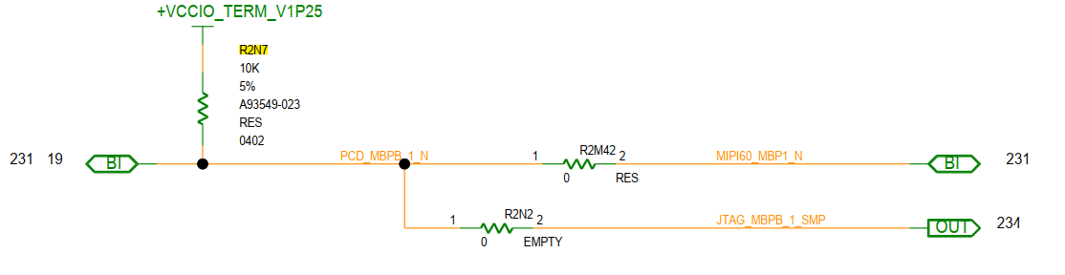
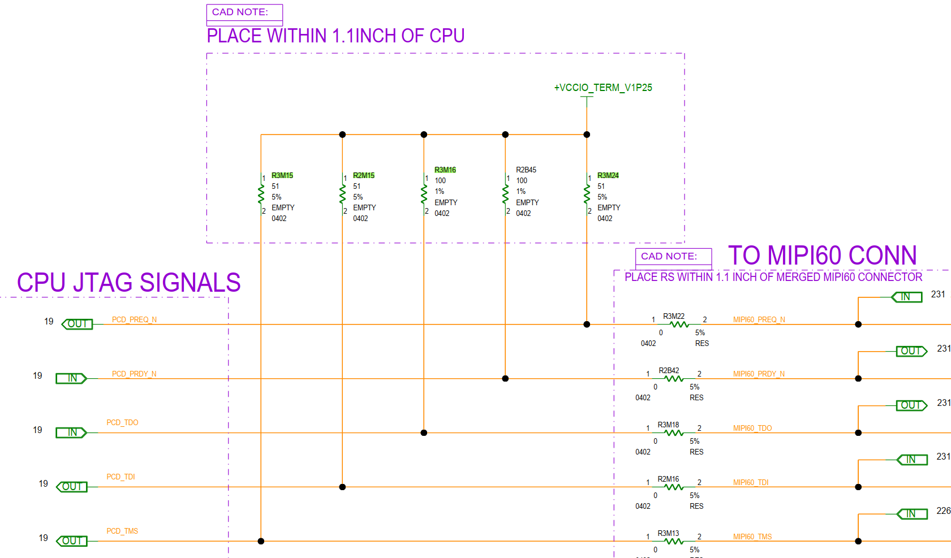
S01x/S02x BOT

Slide 8
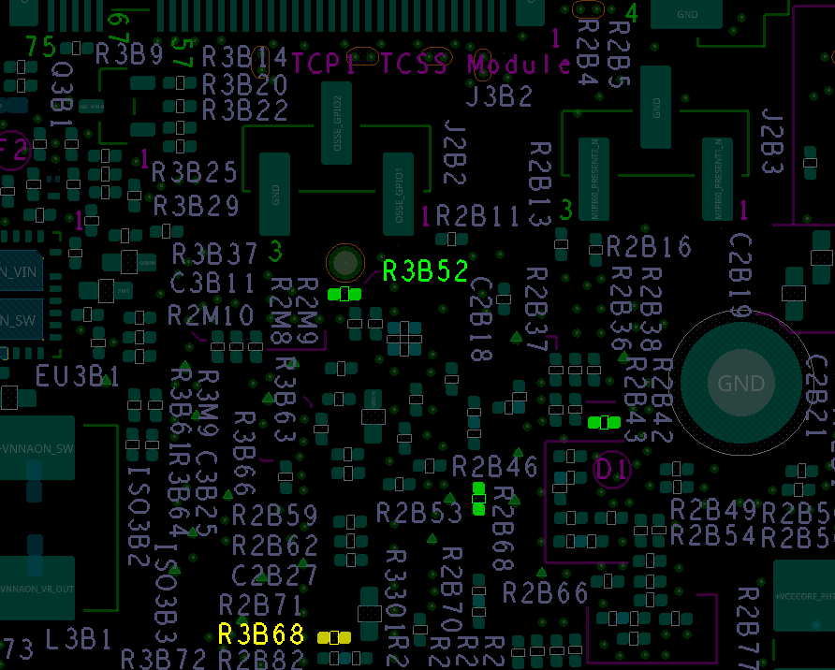
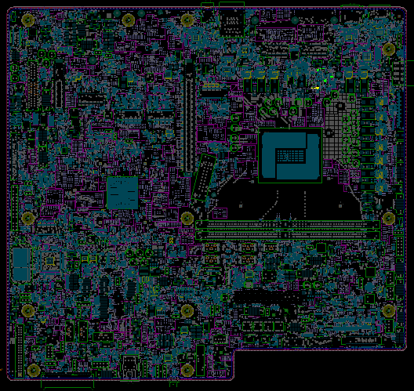
S01x/S02x
Step 1 of 2
Action | REFDES | Description
STUFF | R2B48 | RES D,0402,1.00 kOHM,1.00%,1/16W
STUFF | R3B52 | RES D,0402,51.00 OHM,5.00%,1/16W
STUFF | R2B45 | RES D,0402,100.00 OHM,1.00%,1/16W
REPLACE | R3B68 | RES D,0402,100.00 OHM,1.00%,1/16W
R2B48
R2B45
TOP

Slide 9
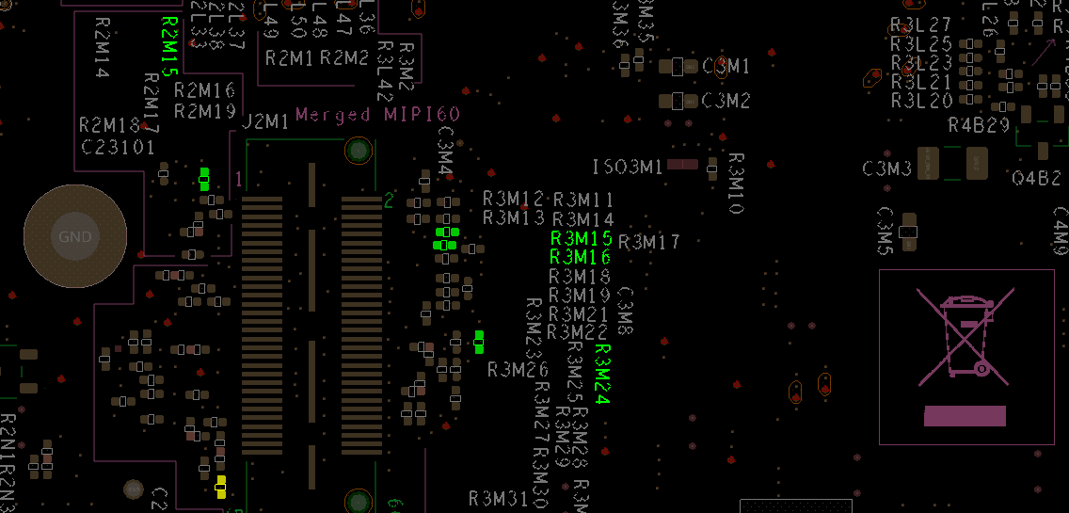
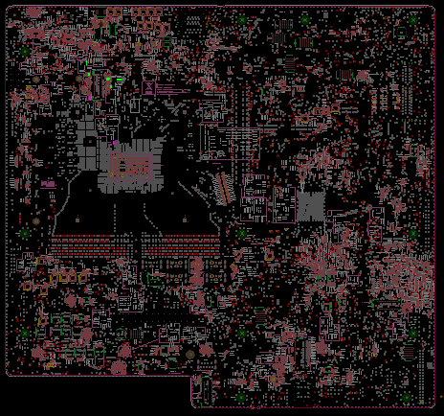
Step 2 of 2
S01x/S02x
R2M15
Action | REFDES | Description
STUFF | R2M15 | RES D,0402,51.00 OHM,5.00%,1/16W
STUFF | R3M15 | RES D,0402,51.00 OHM,5.00%,1/16W
STUFF | R3M16 | RES D,0402,100.00 OHM,1.00%,1/16W
STUFF | R3M24 | RES D,0402,51.00 OHM,5.00%,1/16W
REPLACE | R2N7 | RES D,0402,100.00 OHM,1.00%,1/16W
R2N7
R3M24
BOT

Slide 10
NVL-S S01x/S02x
S-01B To Disable JTAG ODT and Enable Onboard Terminations Rework Summary
Action | Item | REFDES | Current IPN | Description | New IPN | Description
STUFF | Resistor | R2B48 | N/A | N/A | A93548-023 | RES D,0402,1.00 kOHM,1.00%,1/16W
STUFF | Resistor | R3B52 | N/A | N/A | A93549-007 | RES D,0402,51.00 OHM,5.00%,1/16W
STUFF | Resistor | R2B45 | N/A | N/A | A93548-043 | RES D,0402,100.00 OHM,1.00%,1/16W
REPLACE | Resistor | R3B68 | A93549-023 | RES D,0402,10.00 kOHM,5.00%,1/16W | A93548-043 | RES D,0402,100.00 OHM,1.00%,1/16W
STUFF | Resistor | R2M15 | N/A | N/A | A93549-007 | RES D,0402,51.00 OHM,5.00%,1/16W
STUFF | Resistor | R3M15 | N/A | N/A | A93549-007 | RES D,0402,51.00 OHM,5.00%,1/16W
STUFF | Resistor | R3M16 | N/A | N/A | A93548-043 | RES D,0402,100.00 OHM,1.00%,1/16W
STUFF | Resistor | R3M24 | N/A | N/A | A93549-007 | RES D,0402,51.00 OHM,5.00%,1/16W
REPLACE | Resistor | R2N7 | A93549-023 | RES D,0402,10.00 kOHM,5.00%,1/16W | A93548-043 | RES D,0402,100.00 OHM,1.00%,1/16W

Slide 11
S031

Slide 12
S031 TOP

Slide 13
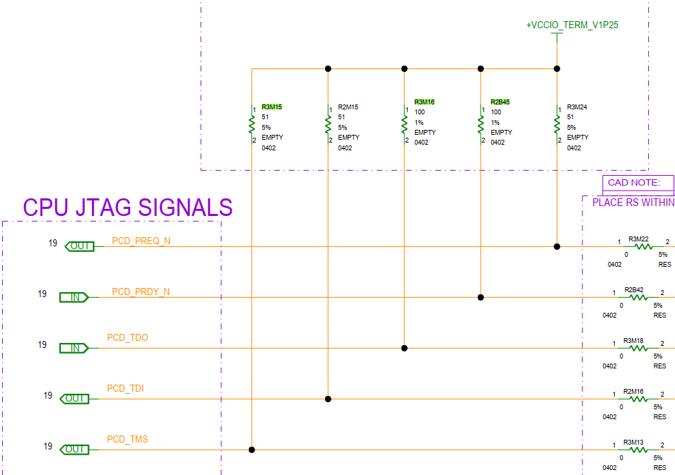
S031 TOP

Slide 14
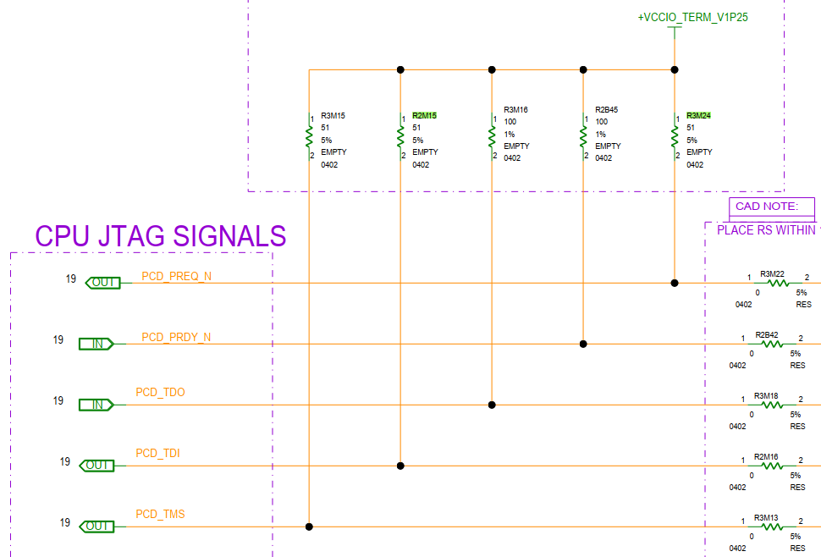
S031 BOT

Slide 15
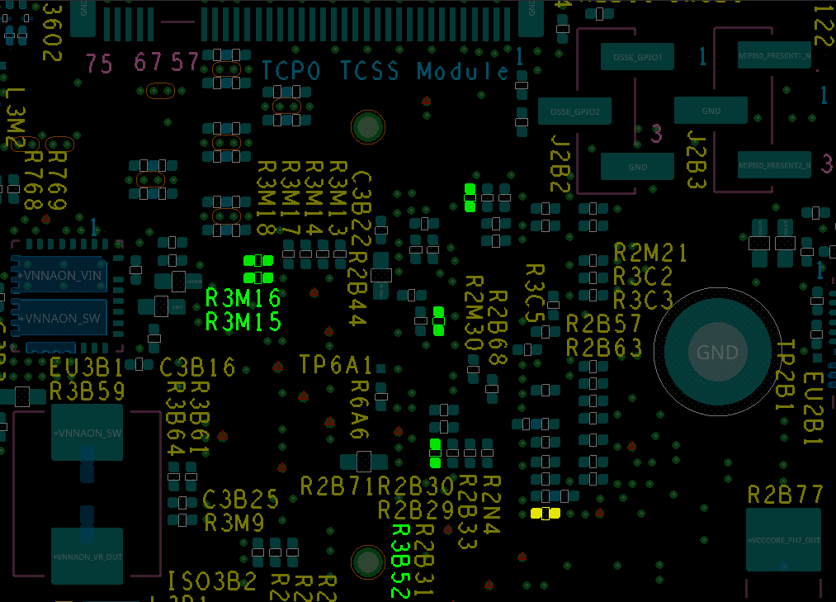
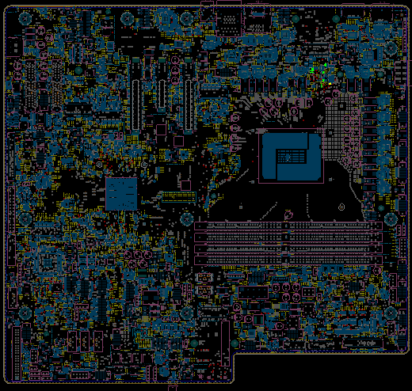
S031
Step 1 of 2
R2B45
Action | REFDES | Description
STUFF | R2B48 | RES D,0402,1.00 kOHM,1.00%,1/16W
STUFF | R3B52 | RES D,0402,51.00 OHM,5.00%,1/16W
STUFF | R3M15 | RES D,0402,51.00 OHM,5.00%,1/16W
STUFF | R3M16 | RES D,0402,100.00 OHM,1.00%,1/16W
STUFF | R2B45 | RES D,0402,100.00 OHM,1.00%,1/16W
REPLACE | R3B68 | RES D,0402,100.00 OHM,1.00%,1/16W
R2B48
R3B68
TOP

Slide 16
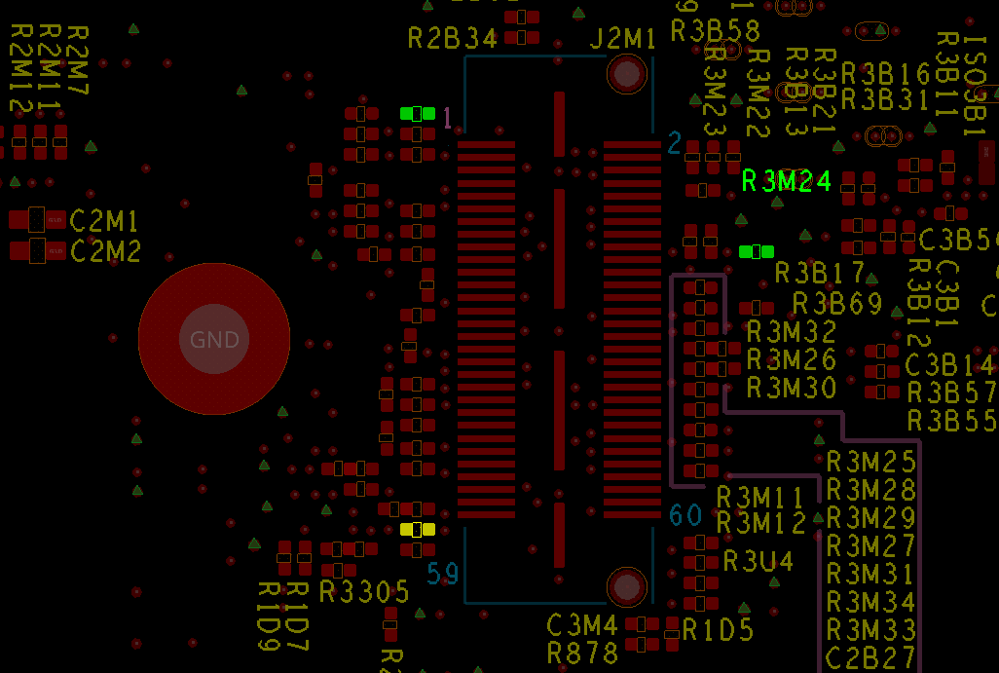
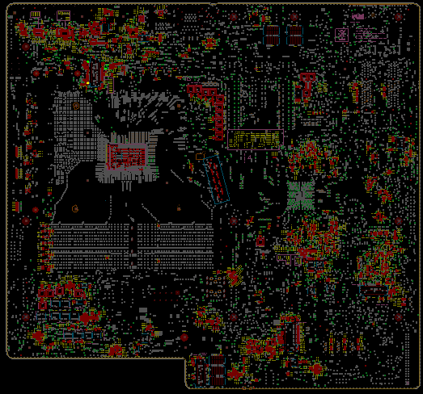
S031
Step 2 of 2
Action | REFDES | Description
STUFF | R2M15 | RES D,0402,51.00 OHM,5.00%,1/16W
STUFF | R3M24 | RES D,0402,51.00 OHM,5.00%,1/16W
REPLACE | R2N7 | RES D,0402,100.00 OHM,1.00%,1/16W
R2M15
R2N7
BOT

Slide 17
NVL-S S031
S-01B To Disable JTAG ODT and Enable Onboard Terminations Rework Summary
Action | Item | REFDES | Current IPN | Description | New IPN | Description
STUFF | Resistor | R2B48 | N/A | N/A | A93548-023 | RES D,0402,1.00 kOHM,1.00%,1/16W
STUFF | Resistor | R3B52 | N/A | N/A | A93549-007 | RES D,0402,51.00 OHM,5.00%,1/16W
STUFF | Resistor | R2B45 | N/A | N/A | A93548-043 | RES D,0402,100.00 OHM,1.00%,1/16W
REPLACE | Resistor | R3B68 | A93549-023 | RES D,0402,10.00 kOHM,5.00%,1/16W | A93548-043 | RES D,0402,100.00 OHM,1.00%,1/16W
STUFF | Resistor | R2M15 | N/A | N/A | A93549-007 | RES D,0402,51.00 OHM,5.00%,1/16W
STUFF | Resistor | R3M15 | N/A | N/A | A93549-007 | RES D,0402,51.00 OHM,5.00%,1/16W
STUFF | Resistor | R3M16 | N/A | N/A | A93548-043 | RES D,0402,100.00 OHM,1.00%,1/16W
STUFF | Resistor | R3M24 | N/A | N/A | A93549-007 | RES D,0402,51.00 OHM,5.00%,1/16W
REPLACE | Resistor | R2N7 | A93549-023 | RES D,0402,10.00 kOHM,5.00%,1/16W | A93548-043 | RES D,0402,100.00 OHM,1.00%,1/16W

Slide 18
from S-01A to S-01B

Slide 19
S01x/S02x

Slide 20
S01x/S02x TOP

Slide 21
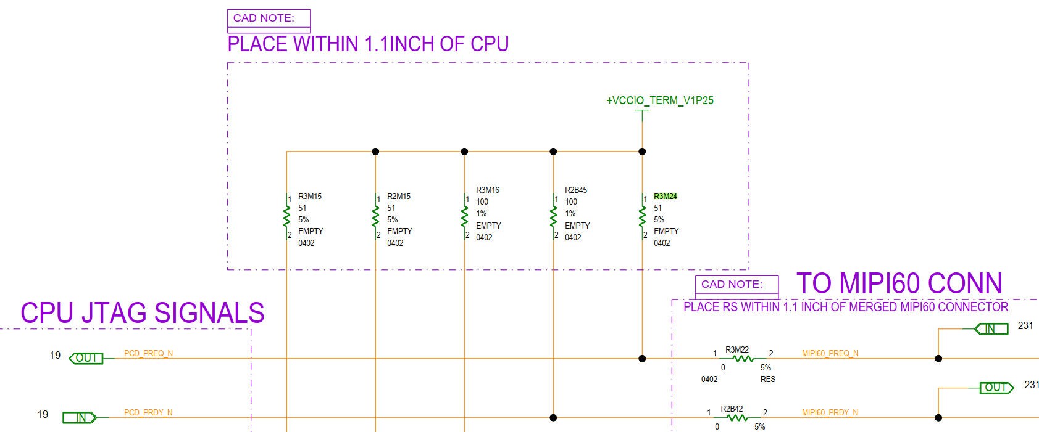
S01x/S02x BOT

Slide 22
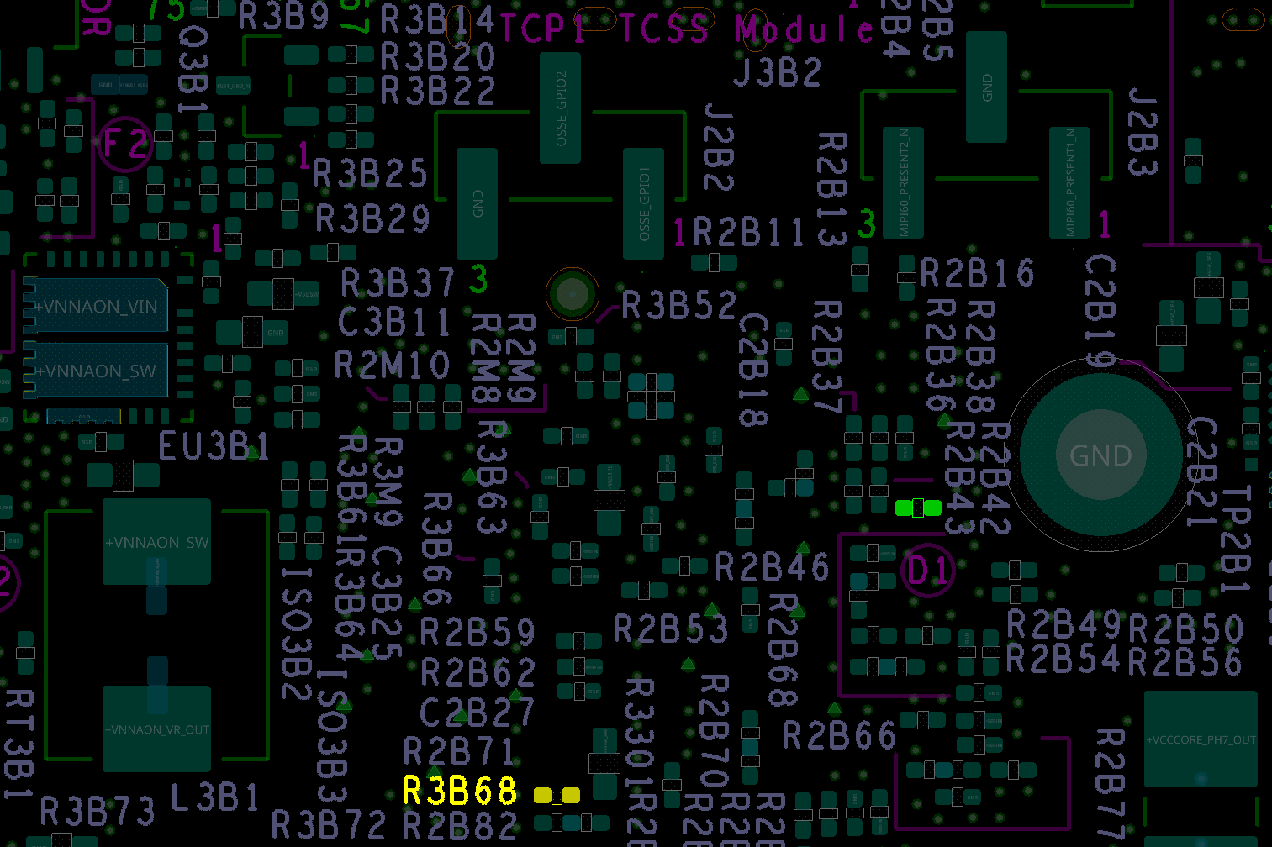
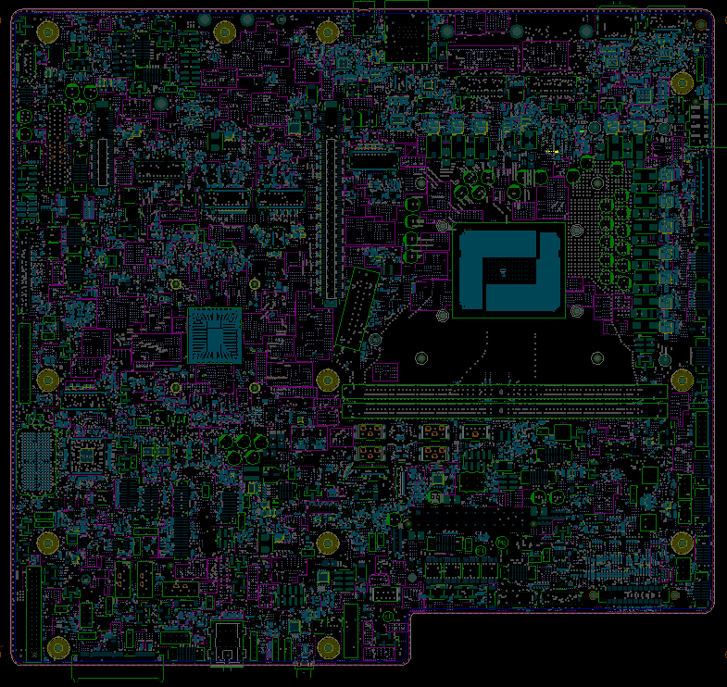
S01x/S02x
Step 1 of 2
Action | REFDES | Description
STUFF | R2B45 | RES D,0402,100.00 OHM,1.00%,1/16W
REPLACE | R3B68 | RES D,0402,100.00 OHM,1.00%,1/16W
R2B45
TOP

Slide 23
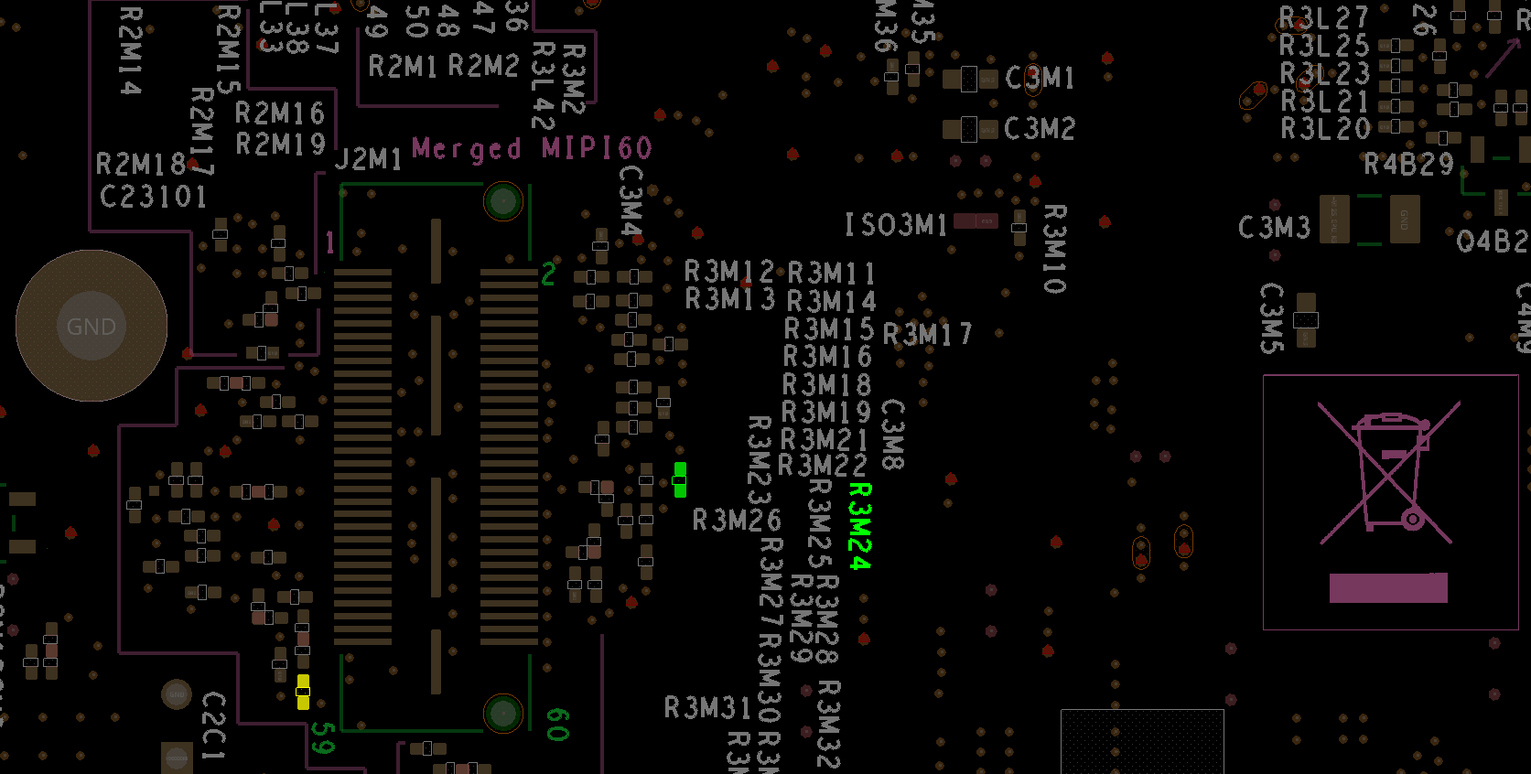
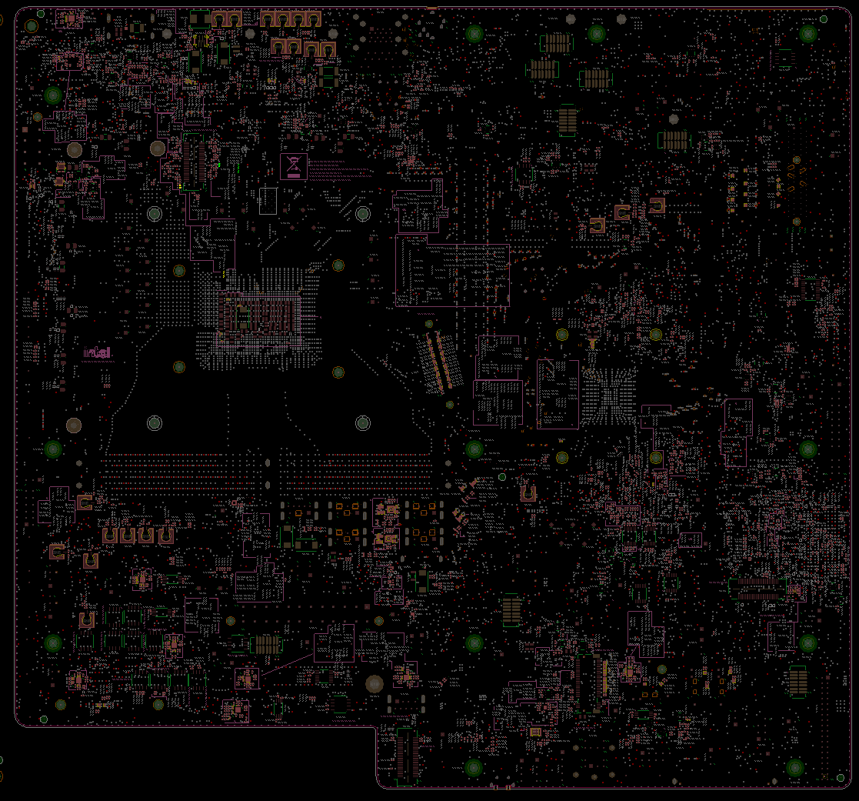
Step 2 of 2
S01x/S02x
Action | REFDES | Description
STUFF | R3M24 | RES D,0402,51.00 OHM,5.00%,1/16W
REPLACE | R2N7 | RES D,0402,100.00 OHM,1.00%,1/16W
R2N7
R3M24
BOT

Slide 24
NVL-S S01x/S02x
[From S-01A to S-01B] To Disable JTAG ODT and Enable Onboard Terminations Rework Summary
Action | Item | REFDES | Current IPN | Description | New IPN | Description
STUFF | Resistor | R2B45 | N/A | N/A | A93548-043 | RES D,0402,100.00 OHM,1.00%,1/16W
REPLACE | Resistor | R3B68 | A93549-023 | RES D,0402,10.00 kOHM,5.00%,1/16W | A93548-043 | RES D,0402,100.00 OHM,1.00%,1/16W
STUFF | Resistor | R3M24 | N/A | N/A | A93549-007 | RES D,0402,51.00 OHM,5.00%,1/16W
REPLACE | Resistor | R2N7 | A93549-023 | RES D,0402,10.00 kOHM,5.00%,1/16W | A93548-043 | RES D,0402,100.00 OHM,1.00%,1/16W

Slide 25
S031

Slide 26
S031 TOP

Slide 27
S031 BOT

Slide 28
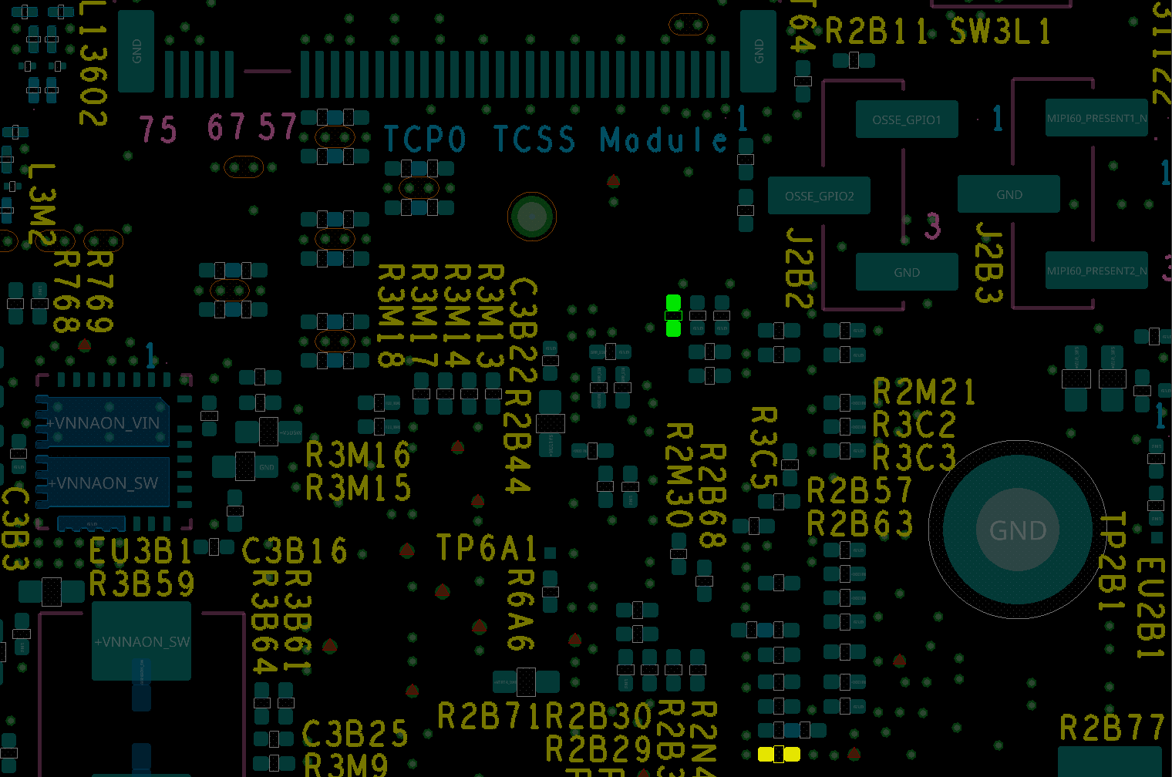
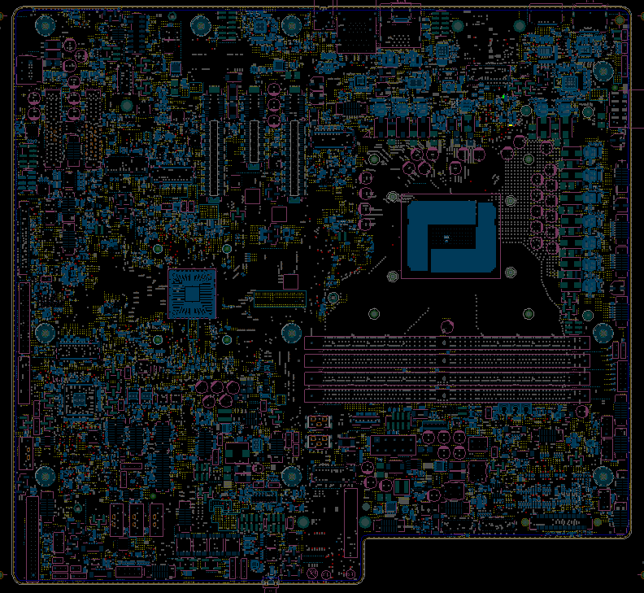
S031
Step 1 of 2
R2B45
Action | REFDES | Description
STUFF | R2B45 | RES D,0402,100.00 OHM,1.00%,1/16W
REPLACE | R3B68 | RES D,0402,100.00 OHM,1.00%,1/16W
R3B68
TOP

Slide 29
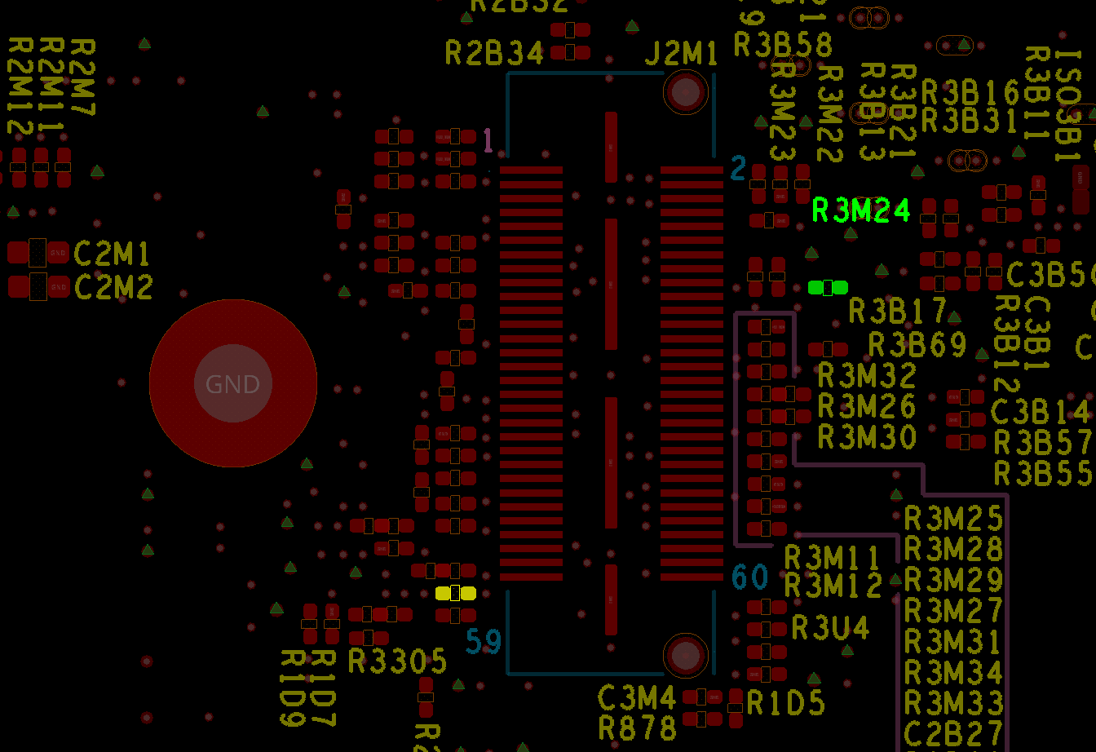
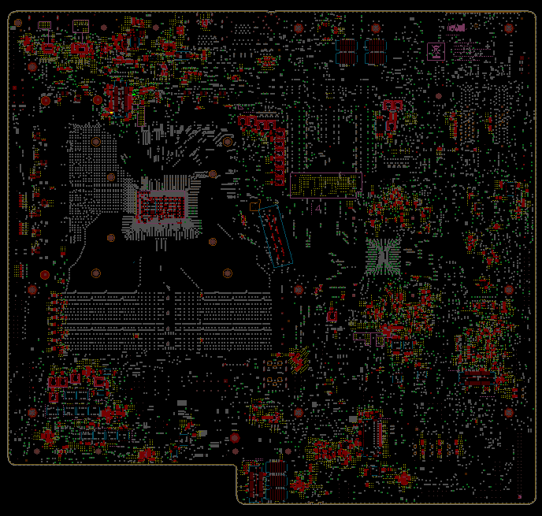
S031
Step 2 of 2
Action | REFDES | Description
STUFF | R3M24 | RES D,0402,51.00 OHM,5.00%,1/16W
REPLACE | R2N7 | RES D,0402,100.00 OHM,1.00%,1/16W
R2N7
BOT

Slide 30
NVL-S S031
[From S-01A to S-01B] To Disable JTAG ODT and Enable Onboard Terminations Rework Summary
Action | Item | REFDES | Current IPN | Description | New IPN | Description
STUFF | Resistor | R2B45 | N/A | N/A | A93548-043 | RES D,0402,100.00 OHM,1.00%,1/16W
REPLACE | Resistor | R3B68 | A93549-023 | RES D,0402,10.00 kOHM,5.00%,1/16W | A93548-043 | RES D,0402,100.00 OHM,1.00%,1/16W
STUFF | Resistor | R3M24 | N/A | N/A | A93549-007 | RES D,0402,51.00 OHM,5.00%,1/16W
REPLACE | Resistor | R2N7 | A93549-023 | RES D,0402,10.00 kOHM,5.00%,1/16W | A93548-043 | RES D,0402,100.00 OHM,1.00%,1/16W

